Slide 1
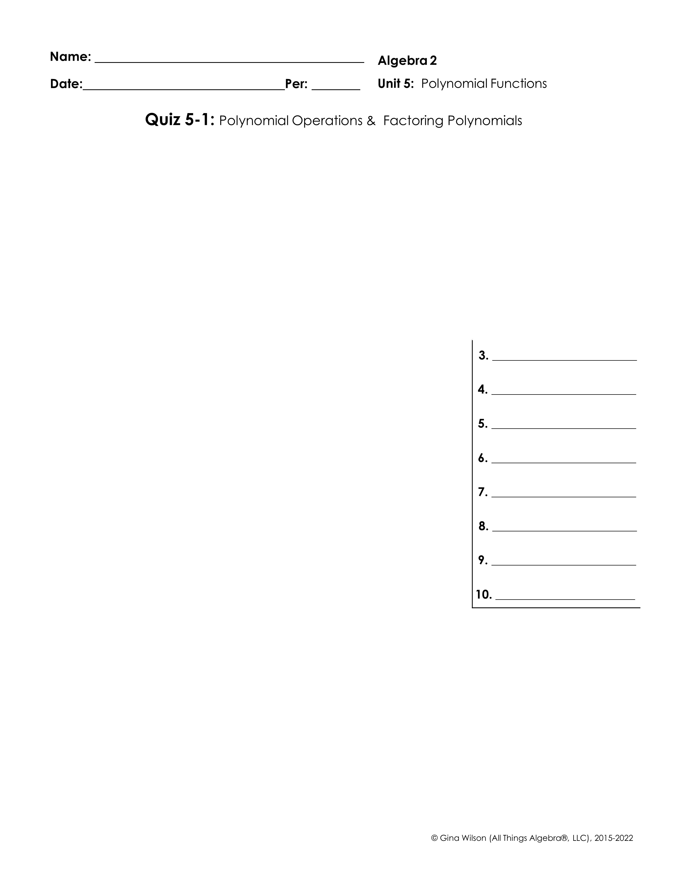
Write each polynomial in standard form. Then classify it by degree and number of terms.
1.
2.
a. Standard form:
a. Standard form:
b. Classify by degree:
b. Classify by degree:
c. Classify by terms:
c. Classify by terms:
Simplify. All answers should be in standard form and contain only positive exponents.
3.
4.
5.
6.
7.
8.
9.
10. Write an expression in simplified form to represent the area of the trapezoid.

Slide 2

Factor each polynomial completely.
11.
12.
13.
14.
15.
16.
17.
18.
19.
20.

